Slide 1

INTRODUCING
OpenPPM
Project Portfolio Management

Slide 2
What is OpenPPM
Open PPM is an open source product, used for Project Management and Project Portfolio Management, in accordance with the PMBOK® (Project Management Body of Knowledge) guide, from PMI® (Project Management Institute). Highlights include:
OpenPPM is a pure web, native cloud solution solution to manage projects, programs and portfolios according to PMI standards
OpenPPM is multi-role, up to 10 roles, but only 5 roles are enough to have the whole functionality (Investment Manager (Sales), Project Manager, Team Member, Resource Manager and PMO)
OpenPPM is open source (Java) working with an open data model that can be integrated with JIRA and Tempo.

Slide 3
OpenPPM Key Features
Investment Management: Investment Details, Dashboard, Investment Probability & Priority
Project Control: Percentage of Completion (POC), Status Report, Integrated Change Control
Project Information: Project Data, Project Charter, Stakeholders, Dependencies, Project Cost Assumptions
Project Scope & Schedule Management: WBS, Deliverables, Activities, Milestones
Project Cost Management: Funding, Baseline, Project Margin, Earned Value Management (EVM)
Resource Management: Project Staffing Demand Management, Resource Pool Management, Resource Capacity Planning, Register Performance Appraisals, Team Calendar
Risk Management: Risk Register, Issues, Assumptions
Procurement Management: SOW & Selection, Work & Payments Schedule, Seller Performance
Program Management: Program Planning and Control, Dashboard, Schedule, Bottom-up Report
Portfolio Management: Portfolio Dashboard, Schedule, Summary Report, KPI
Enhanced Graphic Interface: WBS, Dashboard, Schedule Chart, EVM

Slide 4
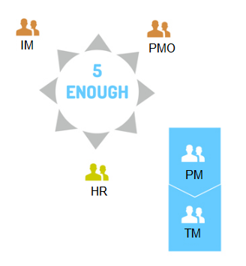
OpenPPM Roles
OpenPPM has 10 possible roles however 5 are enough to manage a portfolio. A user can be assigned multiple roles.
Investment Manager (IM): Responsible for managing the projects pending approval, or investments, providing tracking information.
Project Management Office (PMO): Define processes and quality standards, monitors the performance of programs and components, centralized administrative support and provides information for decision-making.
Resource Manager (RM): Responsible for ensuring the availability of human resources as planned, the capacity management and training.
Project Manager (PM): Responsible for managing the approved projects, leading the project team and provide tracking information.
Team Member (TM): A person assigned to the project team, a source of direct costs, responsible for allocating hours and expenses.

Slide 5
Project Workflow
OpenPPM addresses the complete project management cycle as defined by PMBOK. The depth of usage is defined by company management.
The use of OpenPPM can start with basic requirements as identified by the Blue Spurs Resource List spreadsheet and expand as additional requirements are identified.

Slide 6
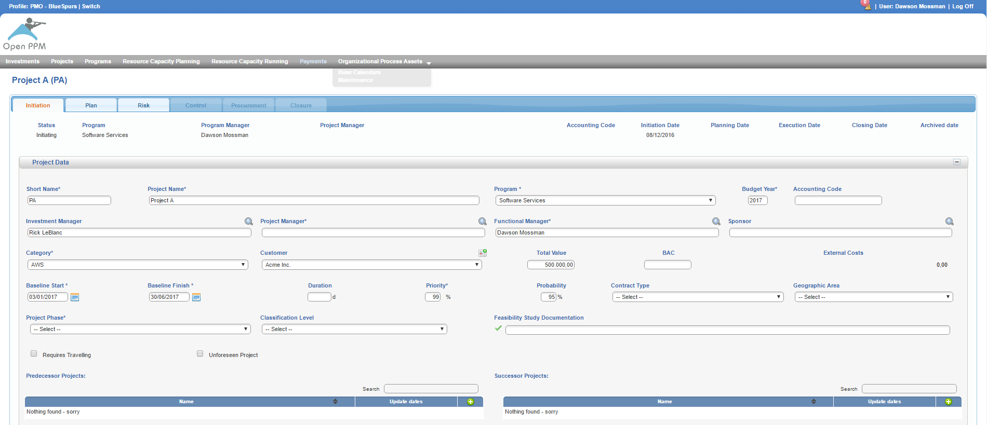
Project Investment - IM
Registers and updates information related to the sales and can include:
Tentative budget
Probability
Priority
Business category
Start and finish baseline
Contract type
Geographic location

Slide 7
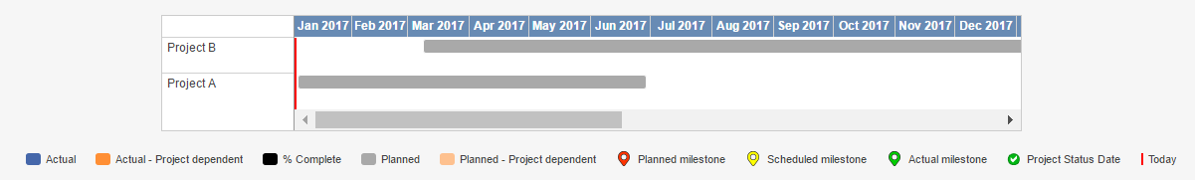
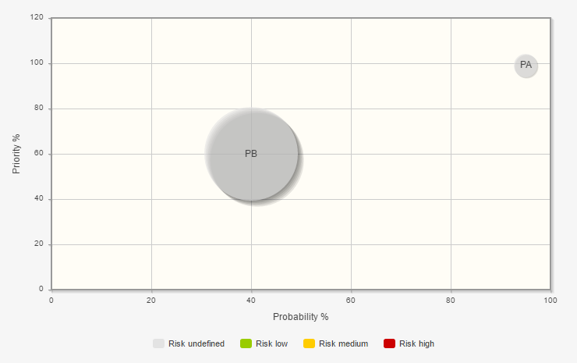

Project Investment - Summary
Investment overviews include:
Future project summaries
Advanced filtering
Status reports
Schedule charts
Probability charts
Links to supporting documentation

Slide 8

Project Planning - PMO
Planning can occur with an investment or an approved project.
Planning includes defining as much as possible:
Project scope (Kanban or Agile by sprint or epic)
Tentative schedule
Planned costs ($, hours, expenses, etc.)
Planned human resources (proposed or assigned)
Team calendar
Planning also includes:
Risk management (risk register, issues and assumptions)
Procurement (SOW, work schedule, payment schedule)

Slide 9
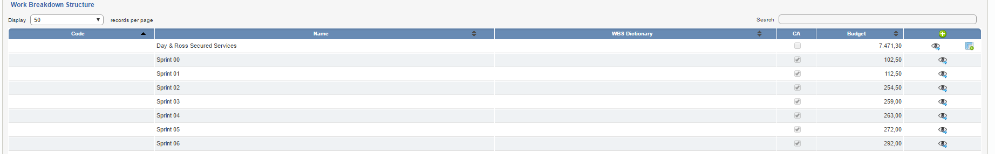
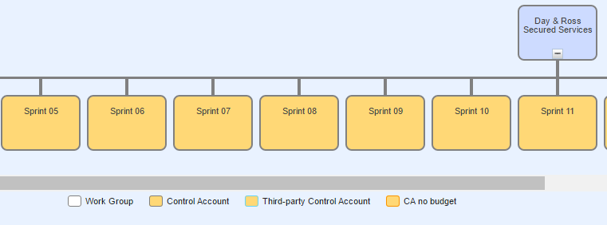
Project Plan Scope
Project scope is the part of project planning that involves determining and documenting a list of specific project goals, deliverables, features, functions, tasks, deadlines, and ultimately costs. Plan Scope In OpenPPM consists of:
Scope statement
Work breakdown structure (WBS)
Deliverables

Slide 10
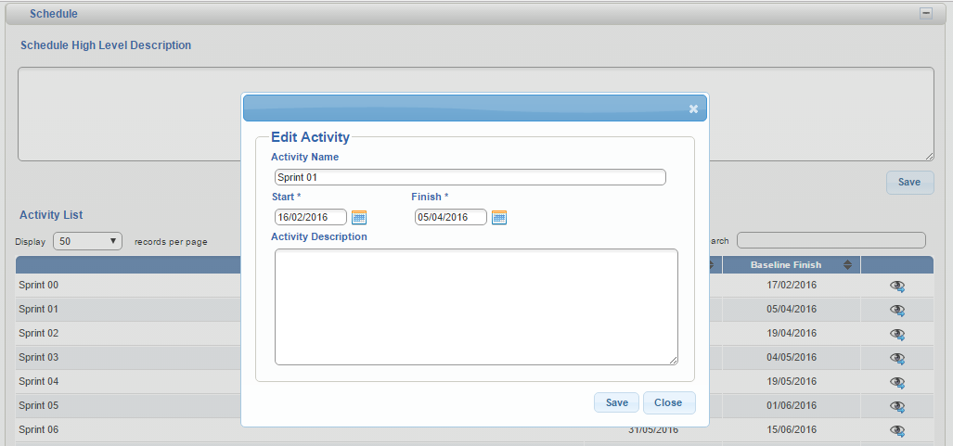
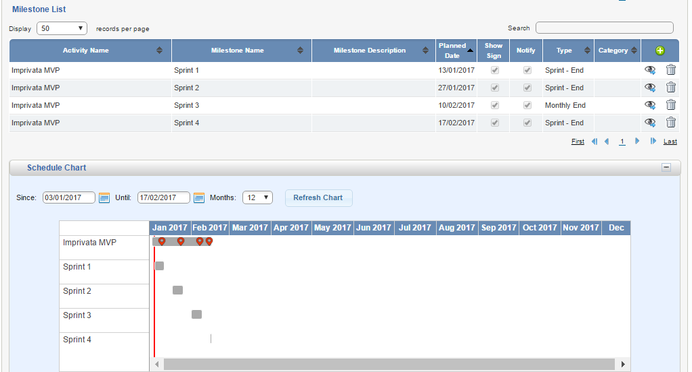
Project Tentative Schedule
Project Schedule consists of:
Schedule high level description
Activity list defining start and finish baseline of the WBS
Milestones
Schedule chart

Slide 11
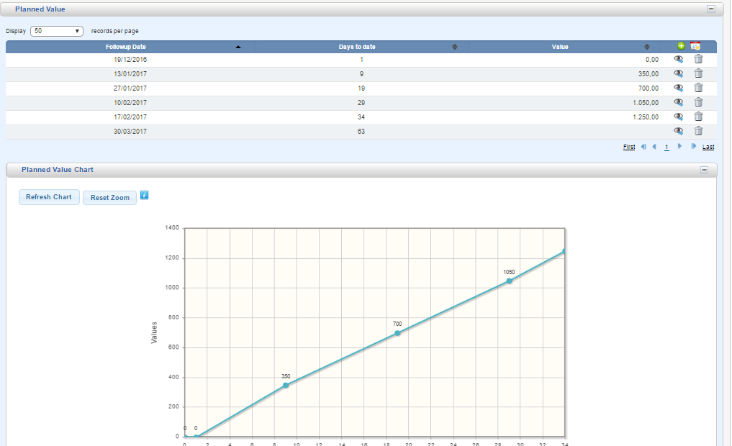
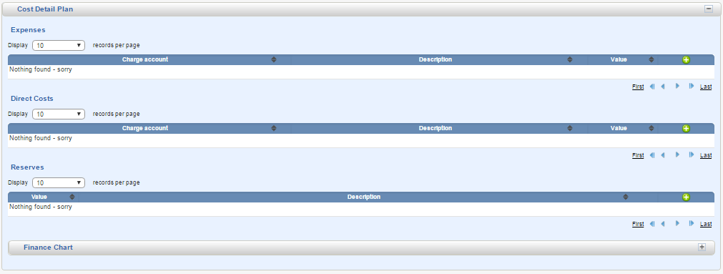
Project Planned Costs
Project Planned Costs reflect the project budget and consists of:
Funding and funding chart
Plan costs and chart (Budget for WBS)
Cost details comprised of expenses, direct costs and reserves
Financial chart

Slide 12
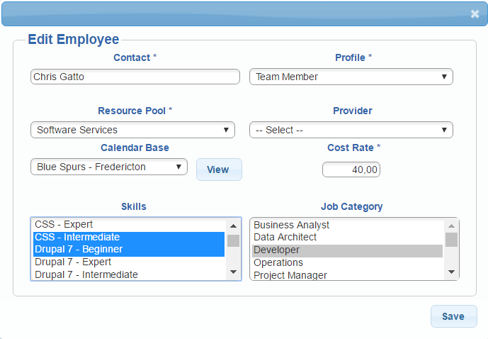
Human Resources
Staff have the role of Team Member. In OpenPPM the staff profile identifies:
Name
Job category(s)
Skills
Resource pool
The PMO can search resources using any grouping of identifiers.
The cost rate is used for planned and controlled costs applied to budget management. Costs can be a charged rate or time unit.

Slide 13
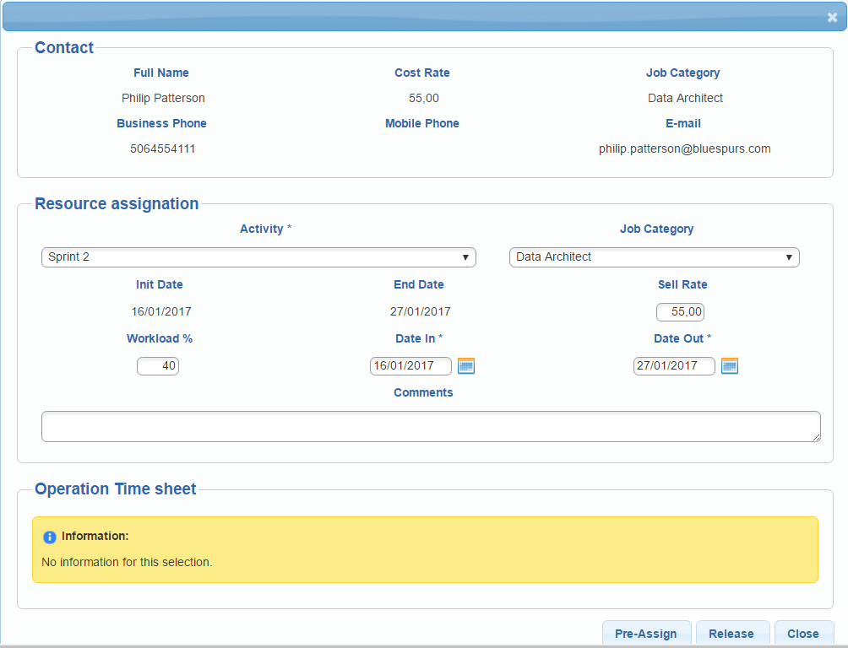
Project Planned Human Resources
The PMO builds a project team by:
Searching for available resources
Once identified they are assigned to an activity based on their job category
Workload % is also entered with an assigned date range. (The default is the activity date range.)
At this point staff are pre-assigned to the project pending approval by RM.

Slide 14
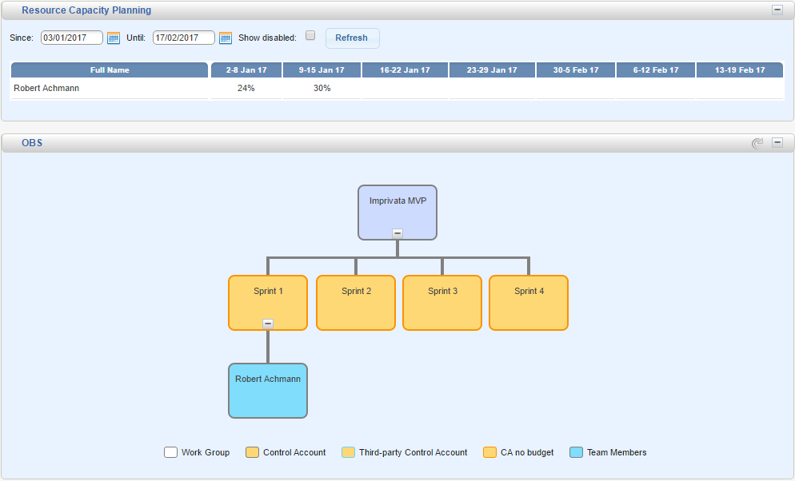
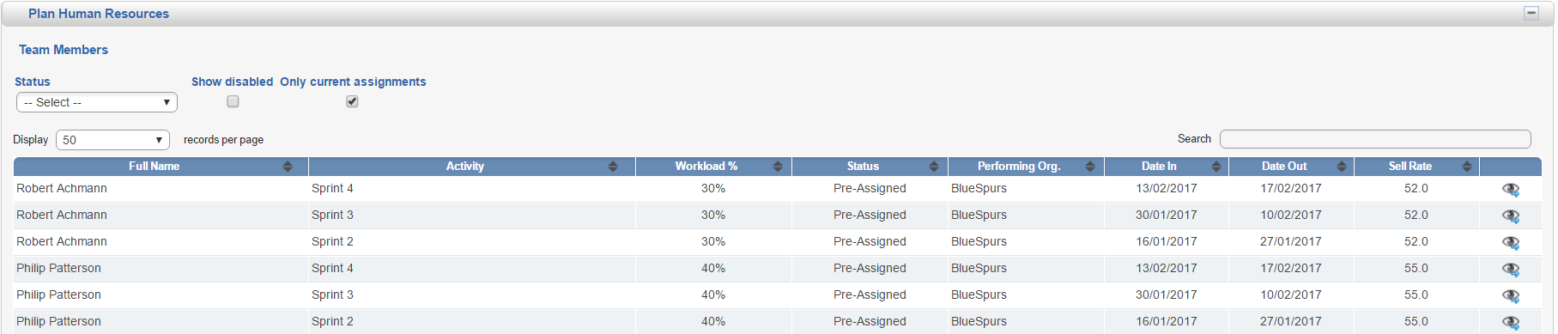
Project Planned Human Resources
With OpenPPM Planned Human Resources consist of:
Team Members
Find available staff
Resource capacity planning grid of approved staff
Organizational breakdown structure for the team

Slide 15
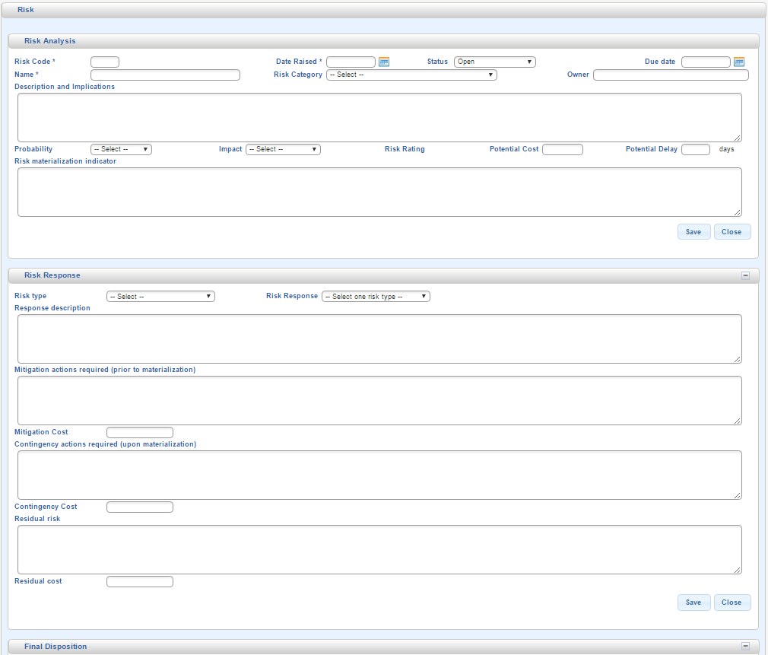
Project Risks, Issues and Assumptions
Within OpenPPM risks, issues and assumptions can be documented at the planning and execution phases.
The Risk Register consists of:
Risk analysis
Risk response
Final disposition
Reassessment log
Risk rating log and chart
Issue management consists of:
Dates raised, due and closed
Assignment
Description and resolution
Assumption management consists of:
Originator
Description
Change management if required

Slide 16
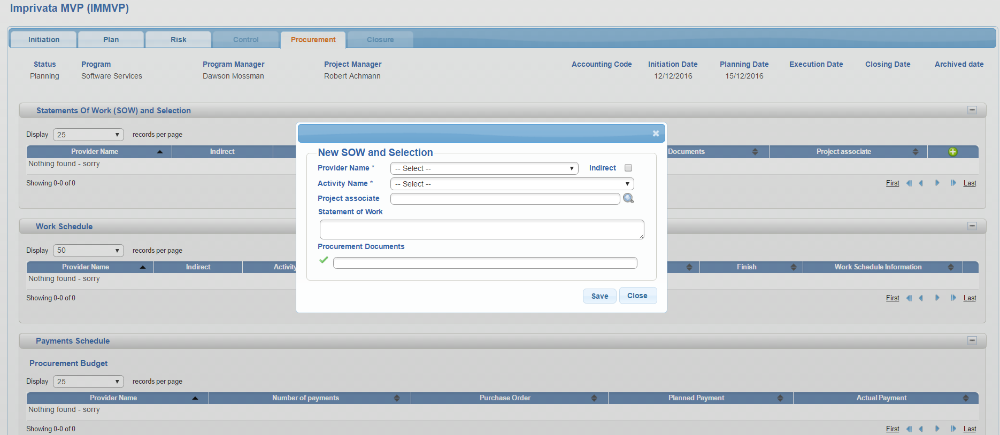
Project Procurement
Project Procurement is the process used to acquire goods and services to support the project like AWS.
Within OpenPPM procurement consists of:
Statement of work
Work schedule
Payment schedule consisting of budget and payments
Provider performance

Slide 17
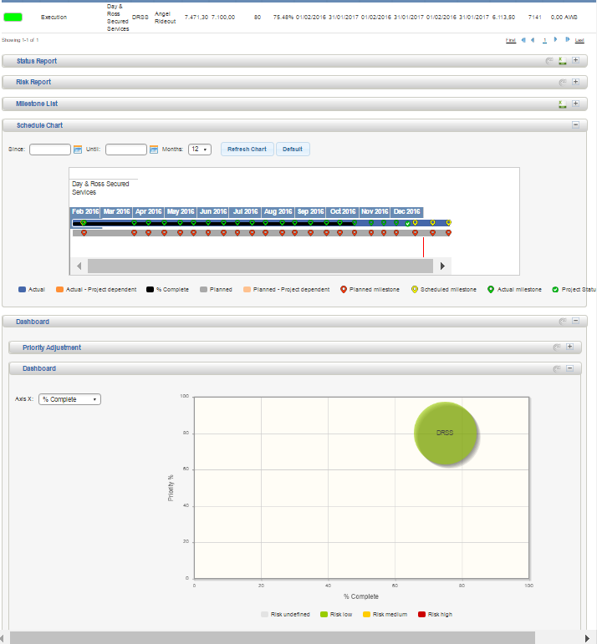
Project Execution
When a project is confirmed it moves from approved to execution and is handed to the PM to control the project.
The PMO is then responsible for monitoring all projects and has access to control functionality.
Upon initial login the PM is presented with an overview of all assigned projects consisting of:
Project summary
Status report
Risk Management
Milestone list
Schedule chart
Dashboard that toggle between % complete, probability, date start, date finish and risk rating

Slide 18
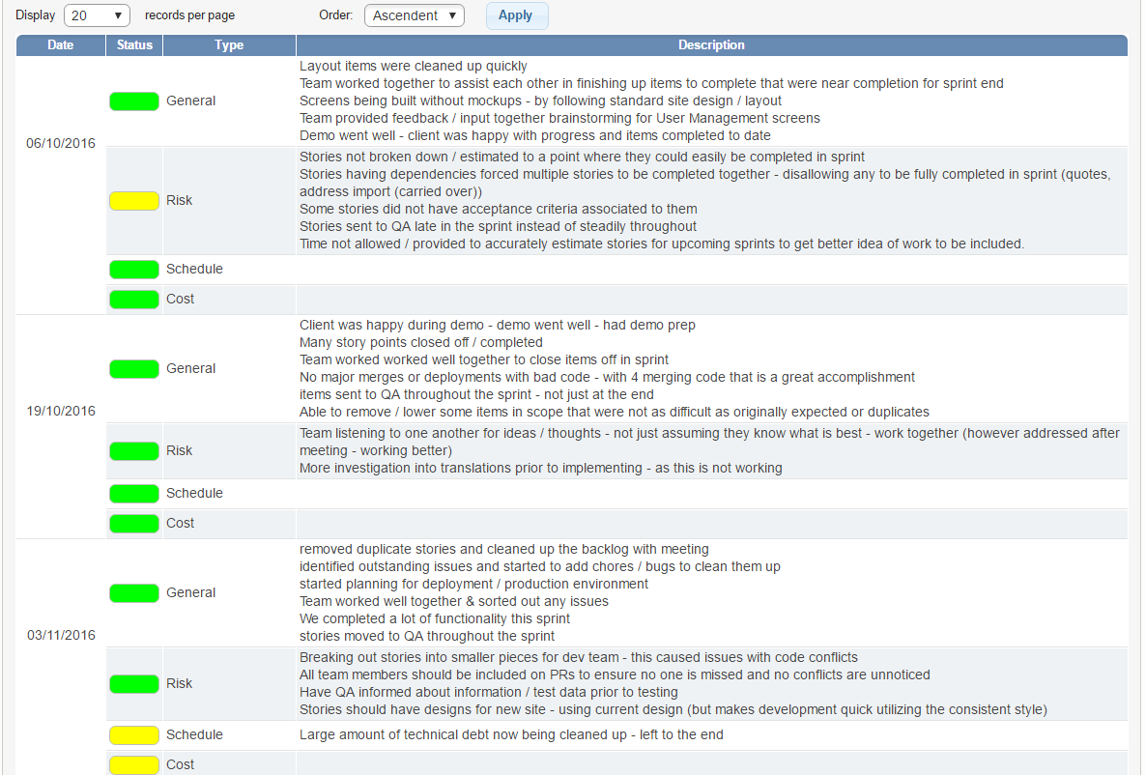
Project Execution - PM
PMs have control over projects they are assigned to. In OpenPPM this is available through the Control tab that consists of:
Control Scope: Project status date, deliverables and viewing WBS
Control Schedule: Activity list, milestones and viewing schedule chart
Control Costs: Viewing control funding and chart, earned value management and viewing control costs
Control Human Resources: Team members management, viewing resource capacity planning, viewing OBS
Status Reports

Slide 19
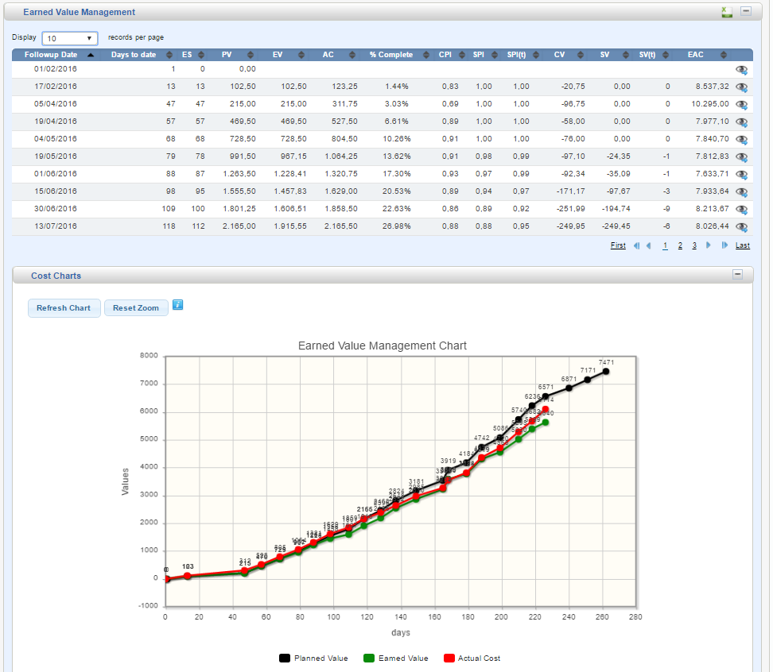
Earned Value Management
Earned Value Management (EVM) helps PM and PMO to measure project performance. It is a systematic project management process used to find variances in projects based on the comparison of worked performed and work planned. EVM is used on the cost and schedule control and can be very useful in project forecasting.
This does require PMs to fully complete JIRA task estimates and insure timesheets are up to date.
With OpenPPM actual costs are based on team member timesheets that can be populated from Tempo
Day & Ross Secured Service EVM

Slide 20
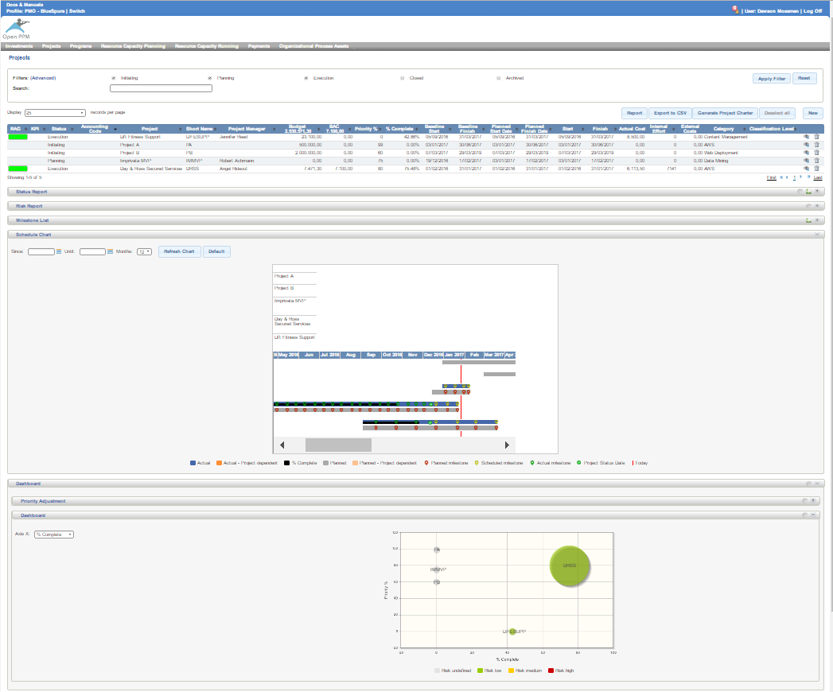
Project Execution - PMO
The PMO is responsible for monitoring and controlling all projects.
Upon initial login the PMO is presented with an overview of all assigned projects consisting of:
Project summary
Status report
Risk Management
Milestone list
Schedule chart
Dashboard that toggle between % complete, probability, date start, date finish and risk rating
Resource capacity planning

Slide 21
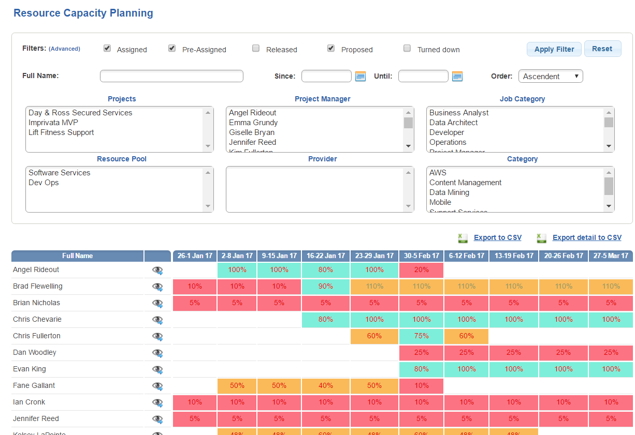
Project Execution - Resources
Resource capacity planning can provide a complete overview of all staff or filtered by any combination of:
Date range
Projects
Resource pool
Project manager
Job category
Project category
By selecting an individual the PMO can also view what projects they are assigned to.

Slide 22

Project Closure
The Project Closure Phase is the last phase in the project life cycle. In this phase, the project will be formally closed and then report its overall level of success. In OpenPPM the closure process includes:
Closing checklist
Lessons learned
Closure report
Closed projects can be achieved to reduce clutter on dashboards.

Slide 23

OpenPPM Demo
Testing of OpenPPM began at the end of 2016 using test data that closely reflects some company projects that included:
Two fictional investments
Project planning
A support services project (Kanban)
A solutions project (Agile)
A demo can be presented using live data
Note: The data used is by no means a reflection of the actual projects and were based on coffee machine discussions with staff plus available data gleaned from JIRA

Slide 24

OpenPPM Implementation
OpenPPM can be installed on AWS and requires:
Apache Tomcat v.7.0.29 or higher (4 GB)
MySQL v.5.1 or higher
MySQL Connector Java 6.0.5-bin.jar
Java v.1.7 or higher
Additional tasks include:
Setting up email services
Scheduling regular database backups
Creating an application to extract staff time from Tempo and populating OpenPPM database (This can be delayed)

Slide 25
OpenPPM Setup
OpenPPM uses a series of code lists to categorize content. It is proposed that the BA work with HR and PMO to define:
Skills
Job categories
Resource pools
Staff profiles
And work with the PMO to define:
Business categories
Geographic Places (?)
Contract types
Funding source (?)
Milestone type
Milestone category
Project phases (?)
Risk categories
Once OpenPPM is setup to company standards training can take place with Management and PMO as data comes on line. It is anticipated that training is minimal since the interface is intuitive

Slide 26

OpenPPM Setup for PMs
It is proposed that the BA work with individual PMs to:
Setup projects
Train on the use of OpenPPM
Monitor use till all projects are on board
OpenPPM will not affect general staff

